Slide 1
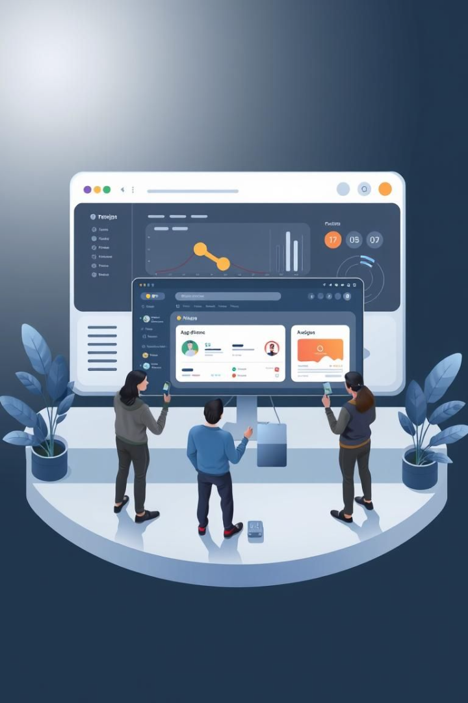
DesignDeck :
Project Overview
DesignDeck offers an attractive interface for project management. It includes UI screenshots showcasing features. The responsive frontend supports light and dark modes. It also has an admin panel and authentication options.

Slide 2
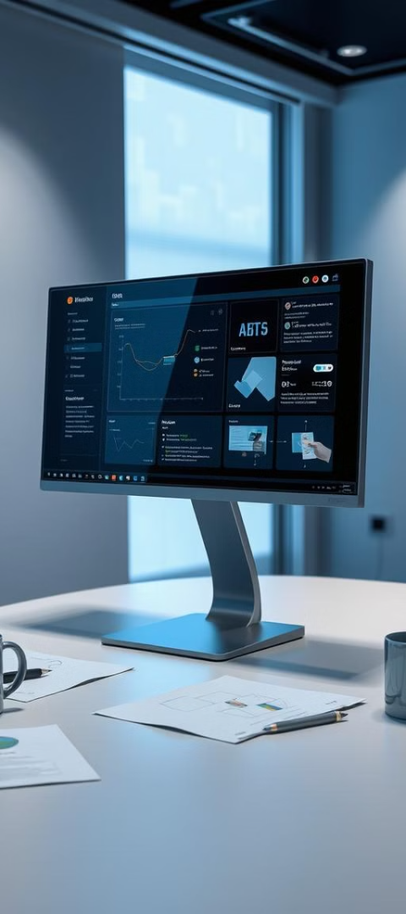

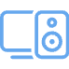

Weekly progress of
DesignDeck
UI Design Complete
Frontend Development
Complete
Backend in
Progress
Edit Profile,
Upload Projects,
Upload Files show on upload page

Slide 3

Phase Completion: UI Design
1
The UI design phase is now complete.
2
The main principles focused on user needs, easy access for everyone, and a uniform design.
3
The design system encompasses typography, color palettes, and UI elements.
4
Examples include bright and attractive colors, easy-to-read fonts, and a well-organized set of design elements.

Slide 4
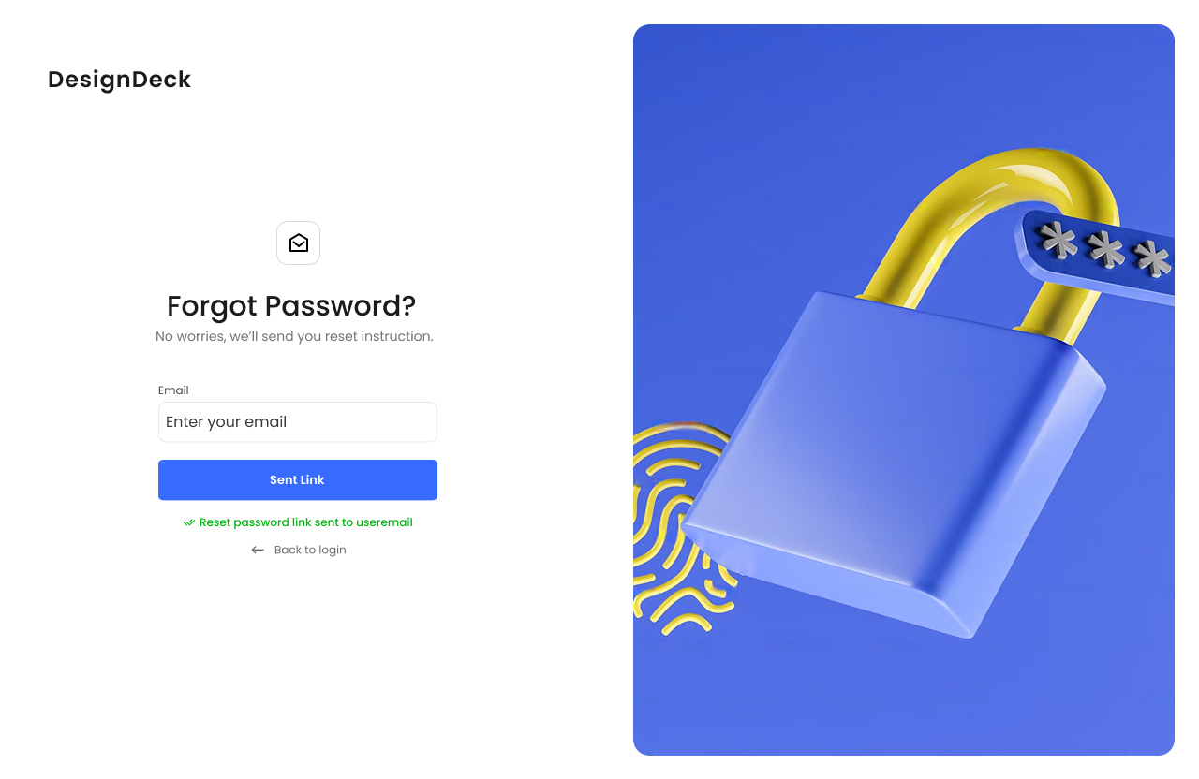
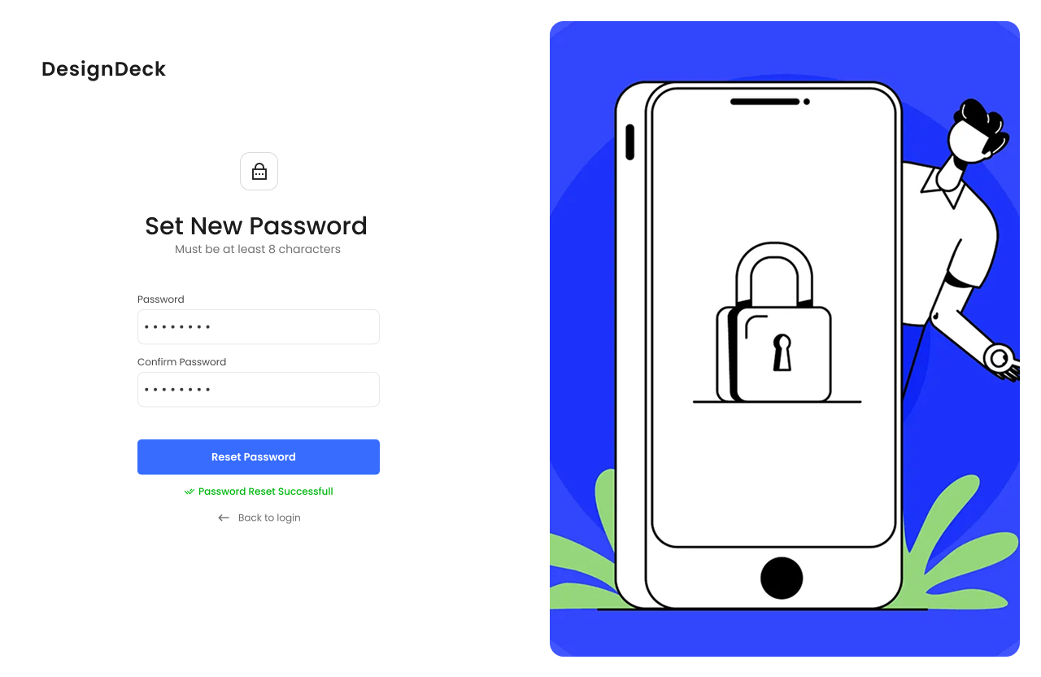
User Interface Screenshots
Sent Link page
Forgot password page

Slide 5
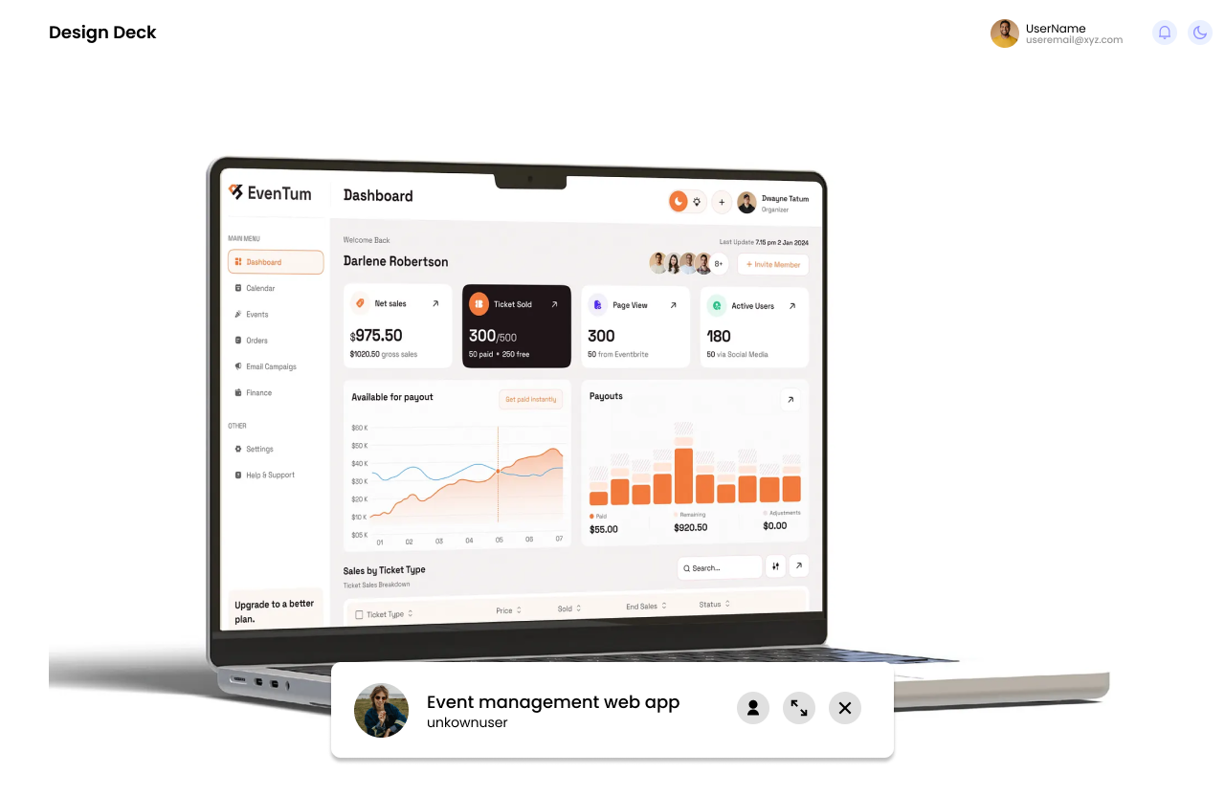
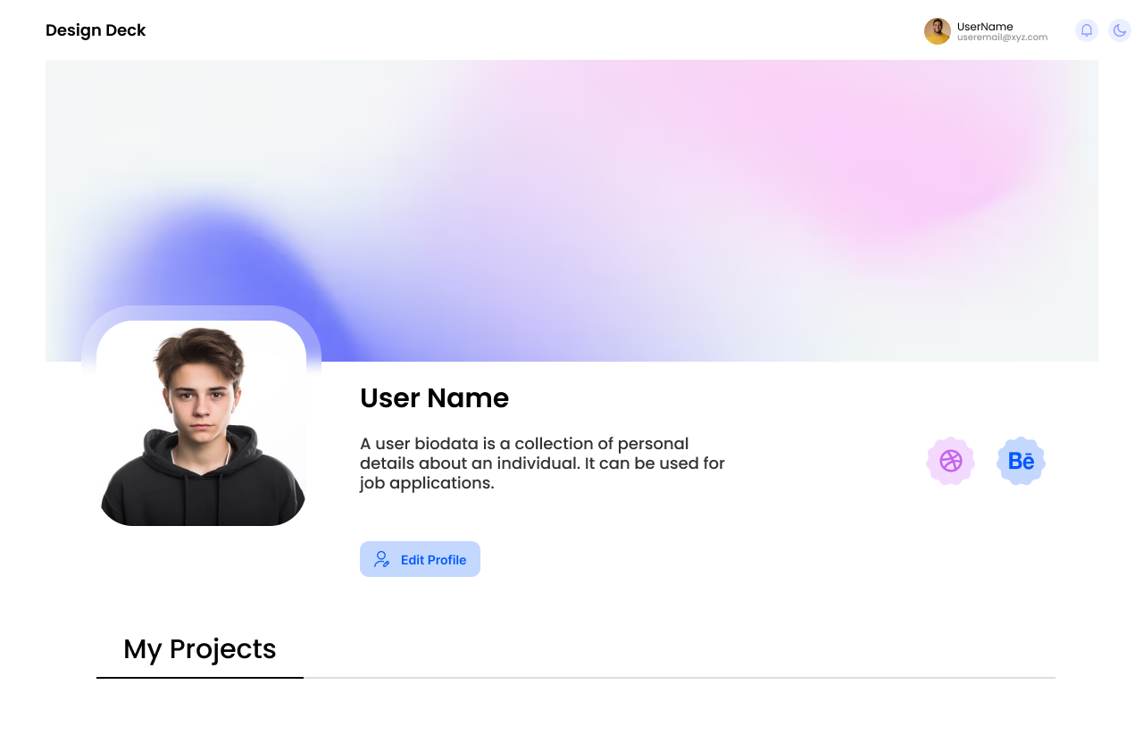
User Interface Screenshots
Particular Project Show Page
Profile page for user

Slide 6
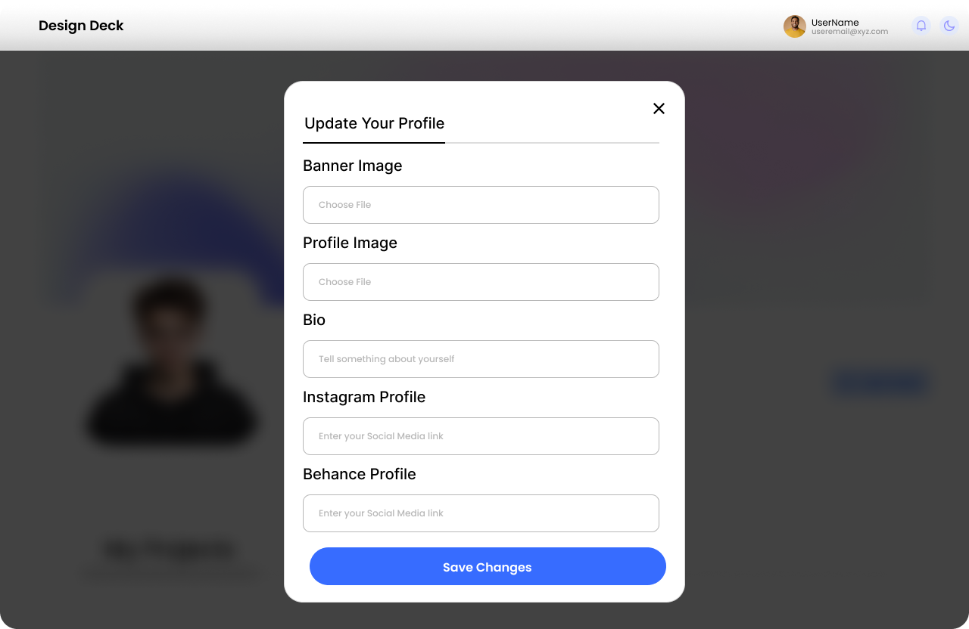
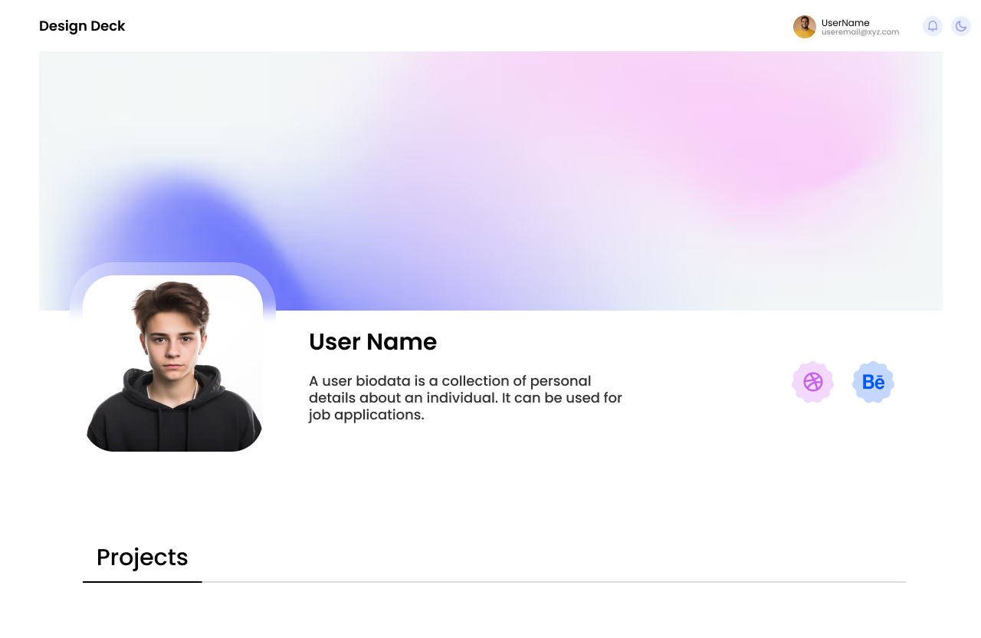
User Interface Screenshots
Edit Profile Page
Profile Page for others users

Slide 7
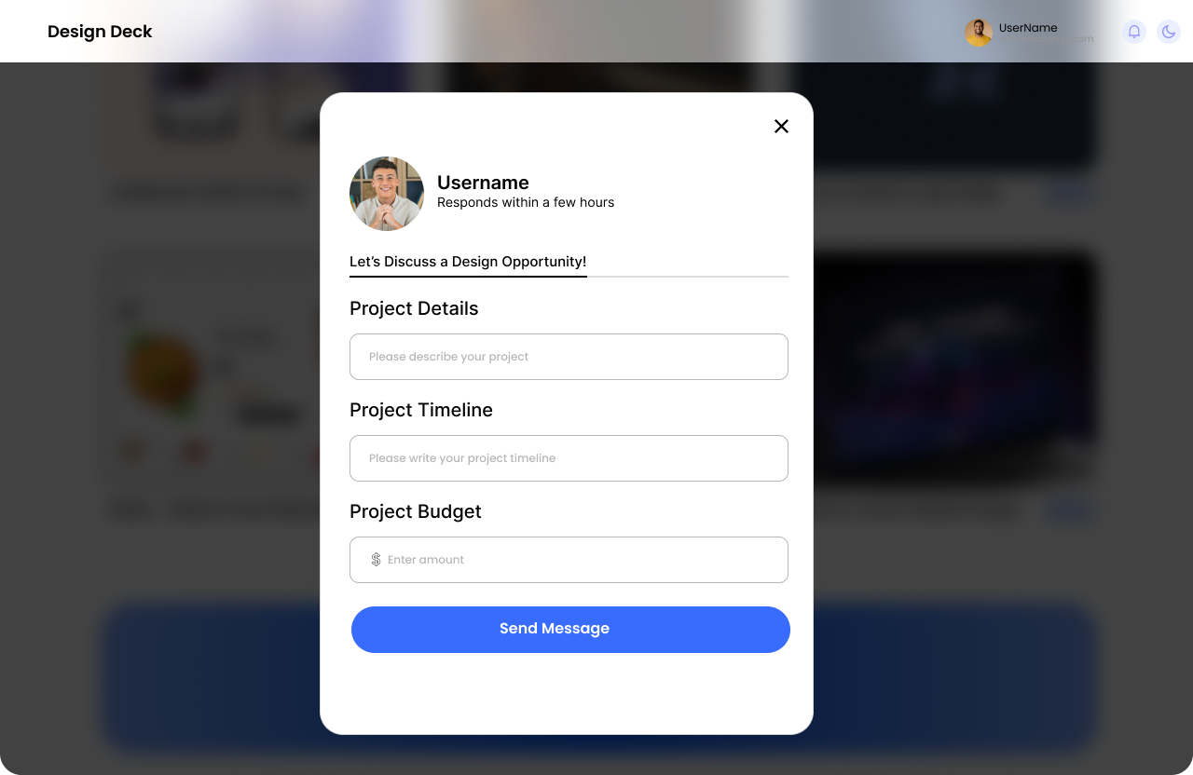
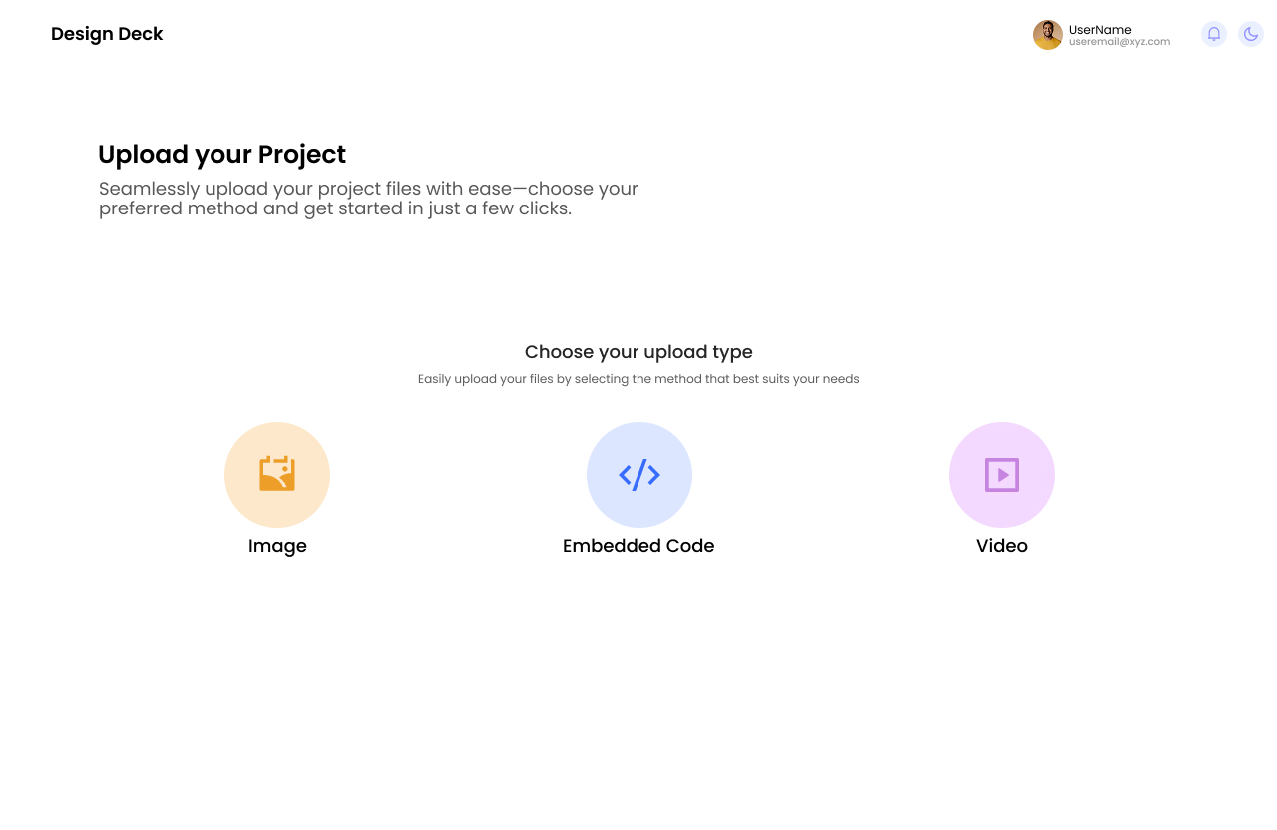
User Interface Screenshots
Contact to other user
Upload Project Page

Slide 8
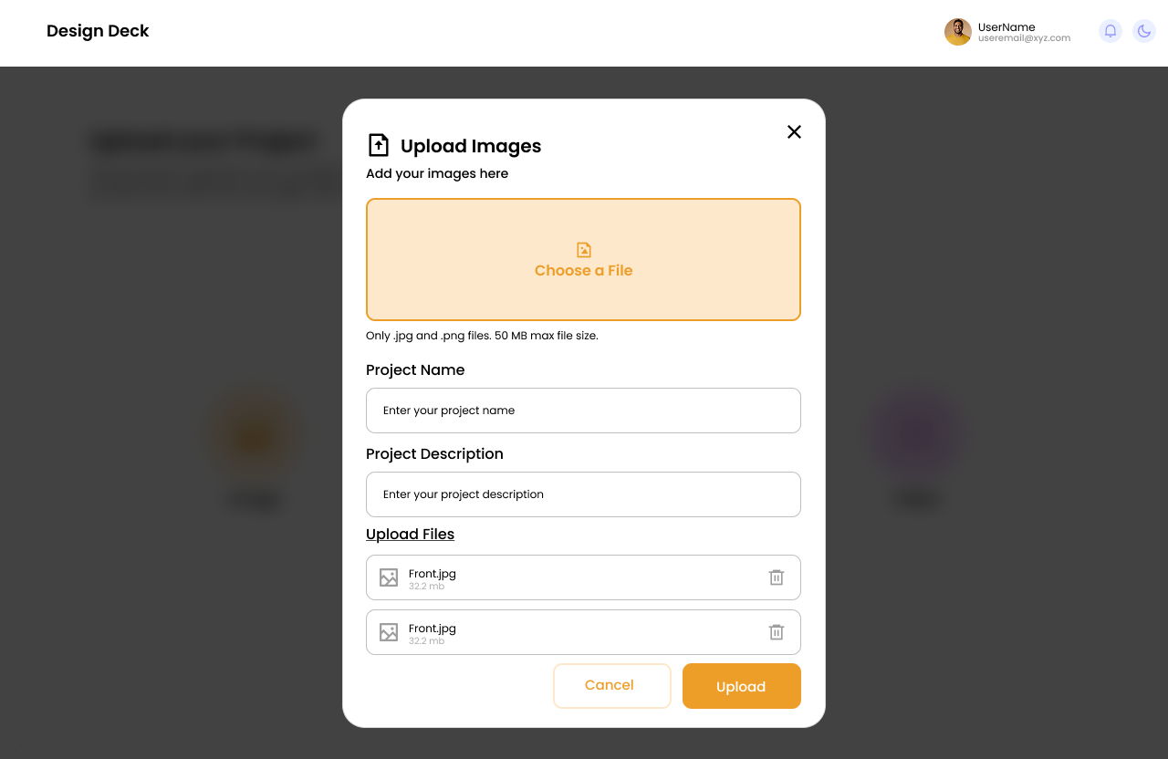
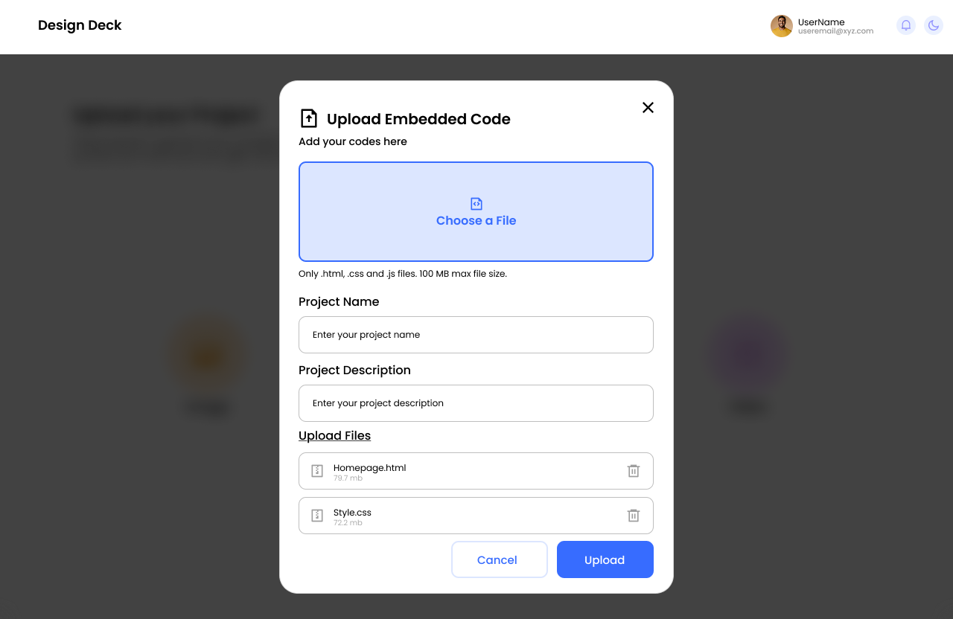
User Interface Screenshots
Image Upload Page
Embedded code Upload Page

Slide 9
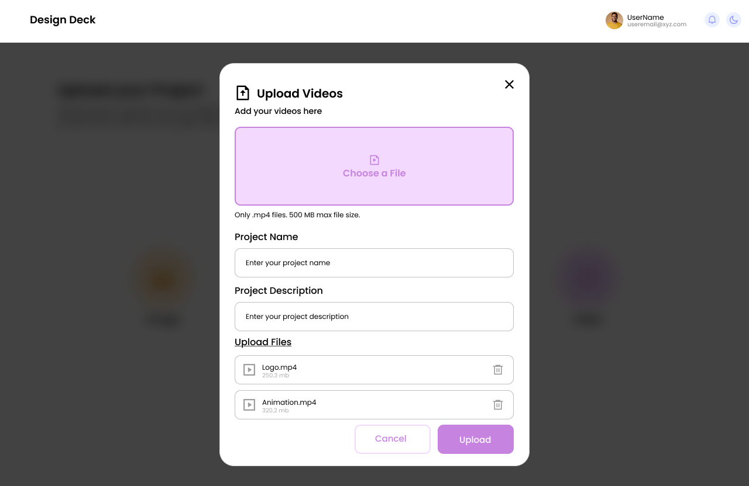
User Interface Screenshots
Video Upload Page

Slide 10



Frontend Development Complete
Mobile-First
Cross-Browser
React
Optimal viewing experience on all devices.
Compatible with Chrome, Firefox, Safari, and Edge.
Built with React, Javascript, HTML5, and Tailwind CSS.
The frontend development emphasizes a smooth and responsive interface for users on any device.

Slide 11
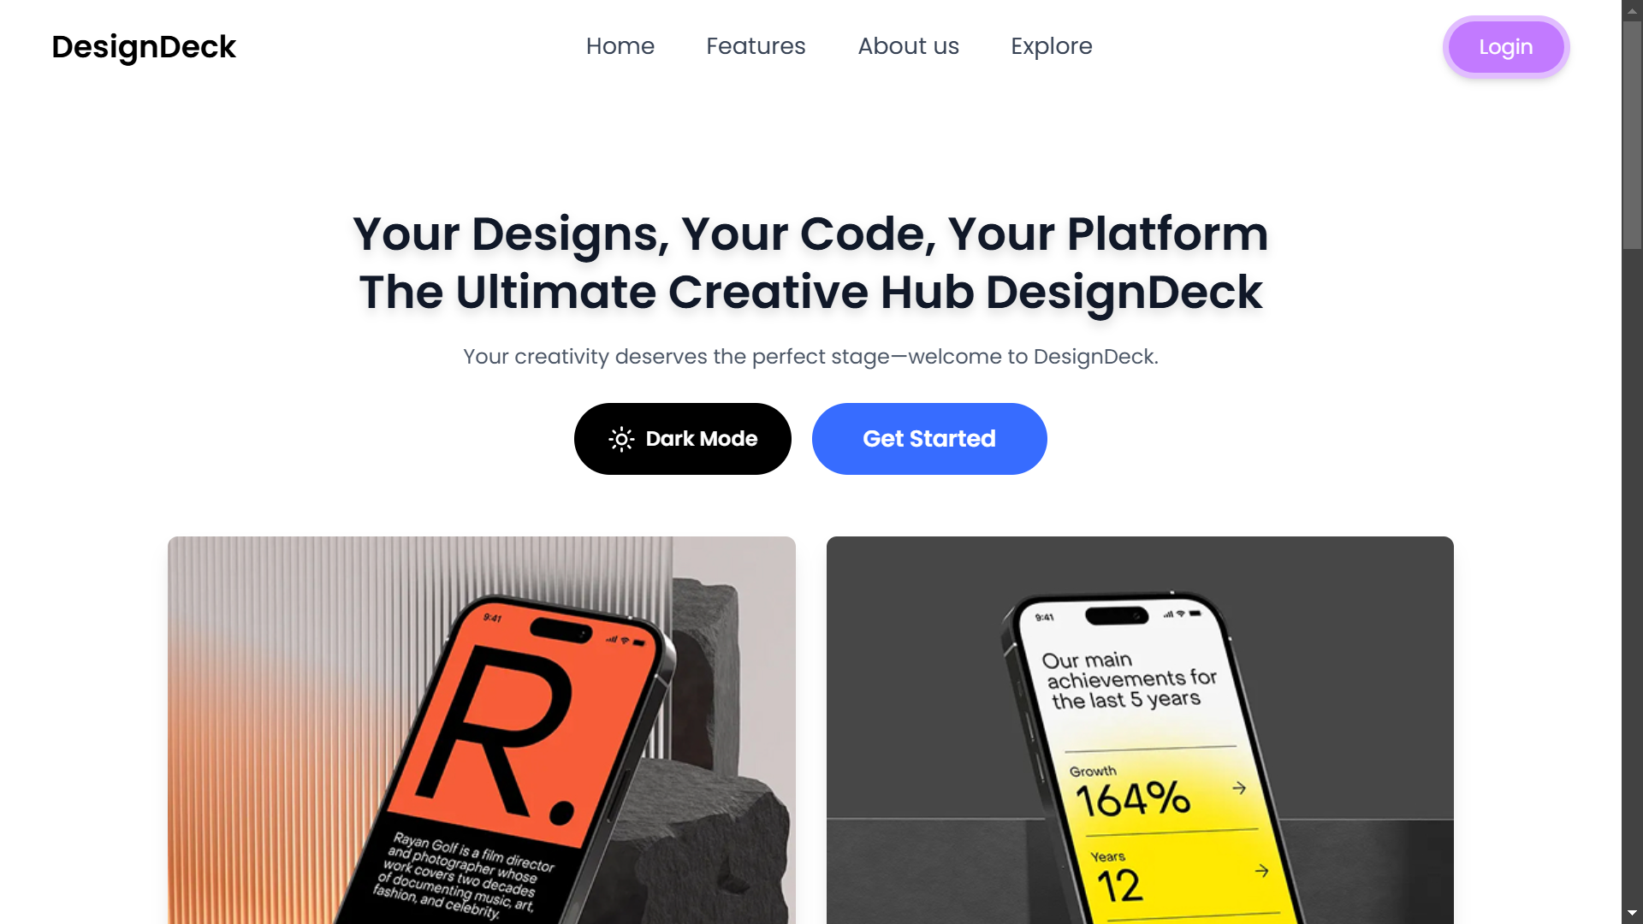
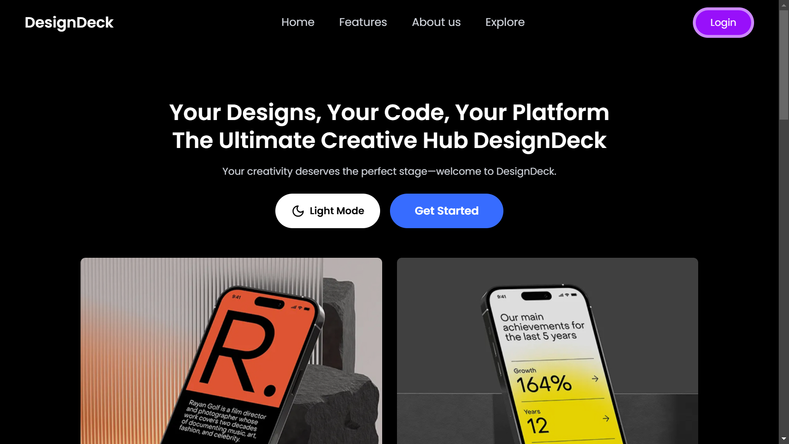
Screenshot Showcase : Frontend Development
Landing Page
Light Mode
Dark Mode

Slide 12
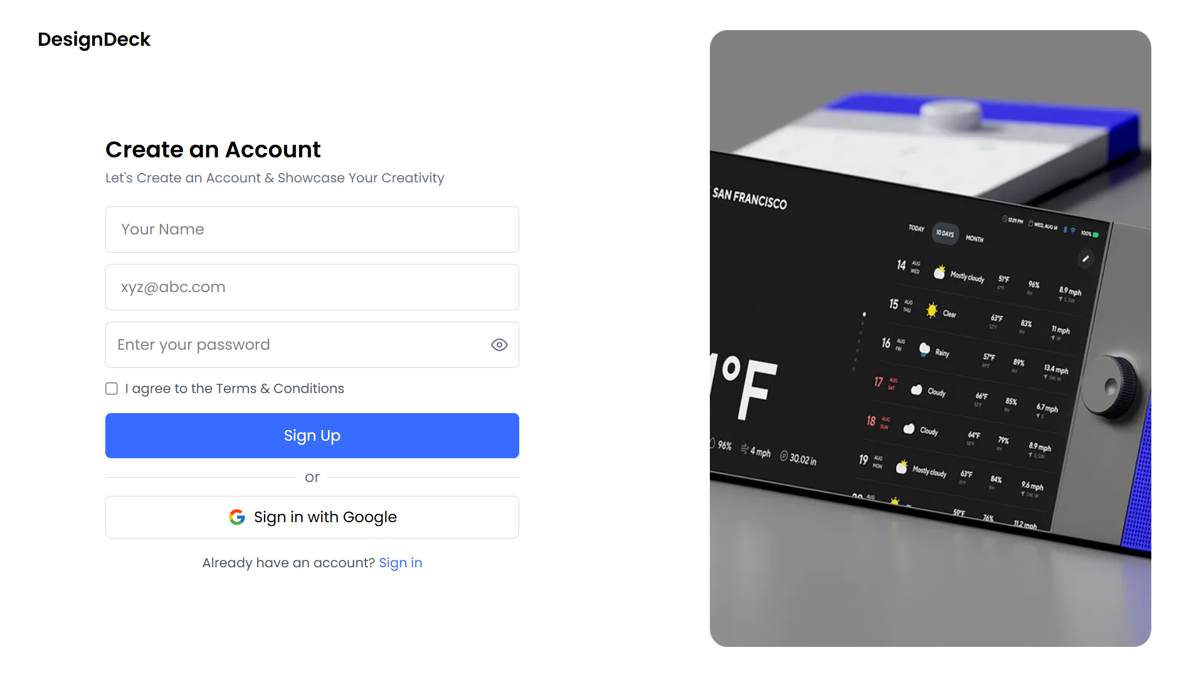
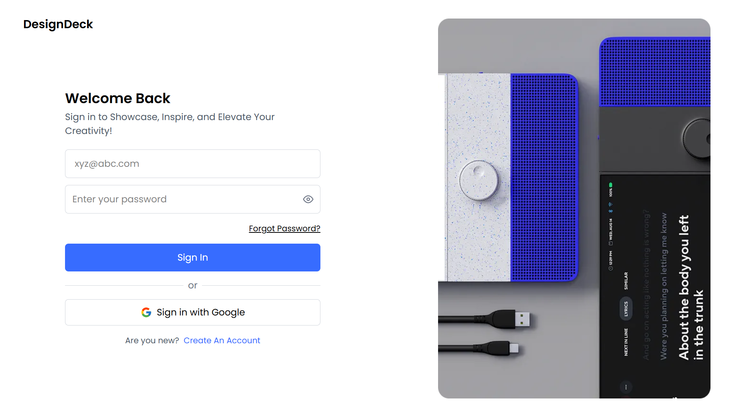
Screenshot Showcase : Frontend Development
Signup Page
Signin Page

Slide 13
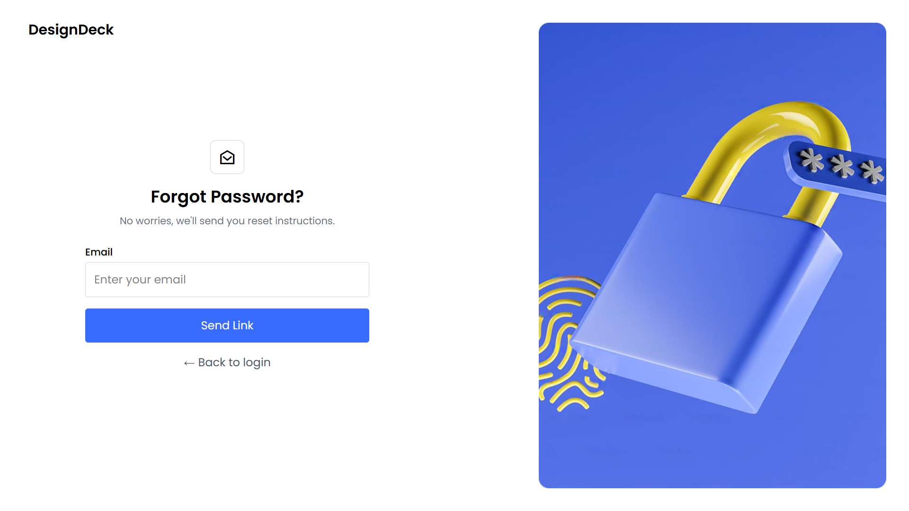
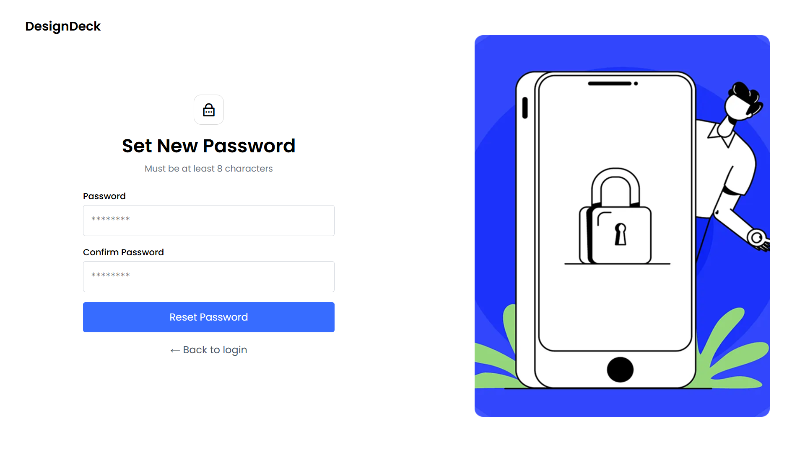
Screenshot Showcase : Frontend Development
Sent Link Page
Reset Password Page

Slide 14
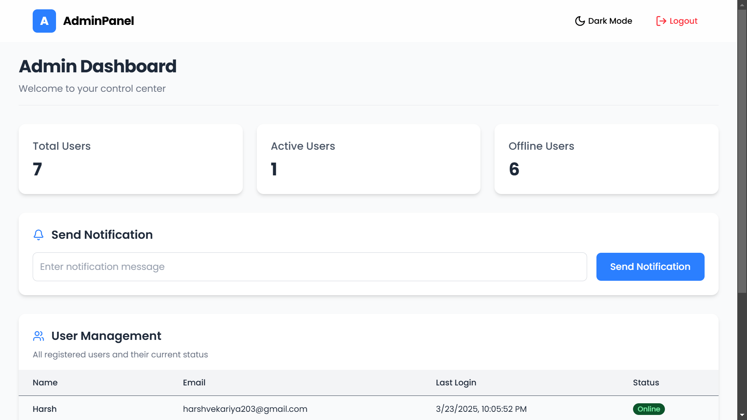
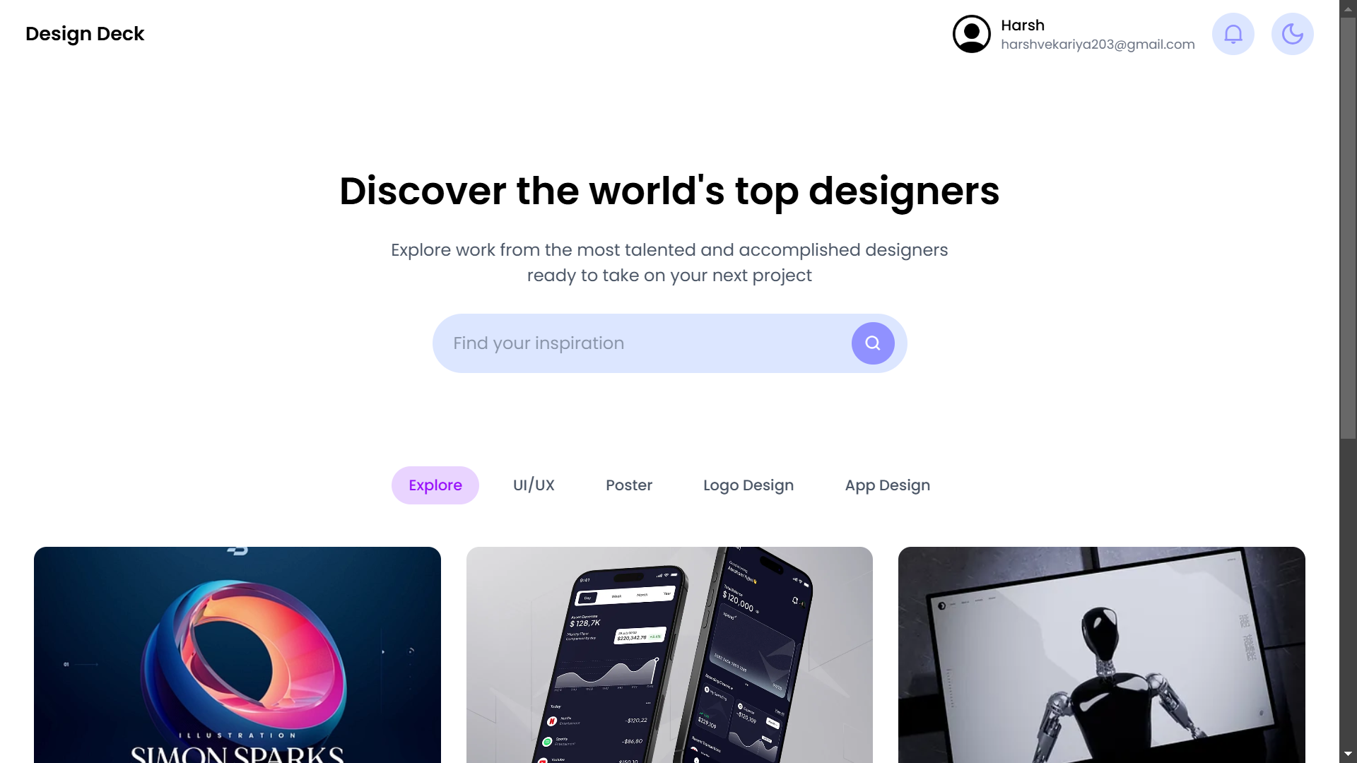
Screenshot Showcase : Frontend Development
Admin Dashboard
User Dashboard

Slide 15
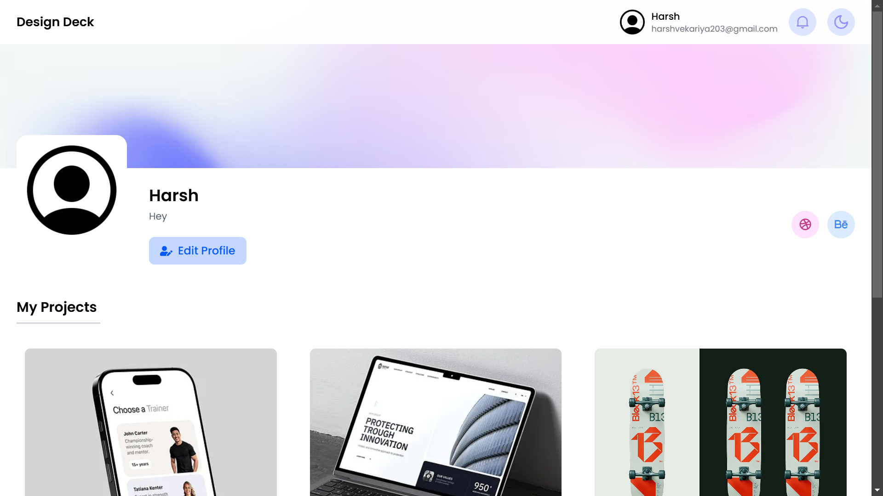
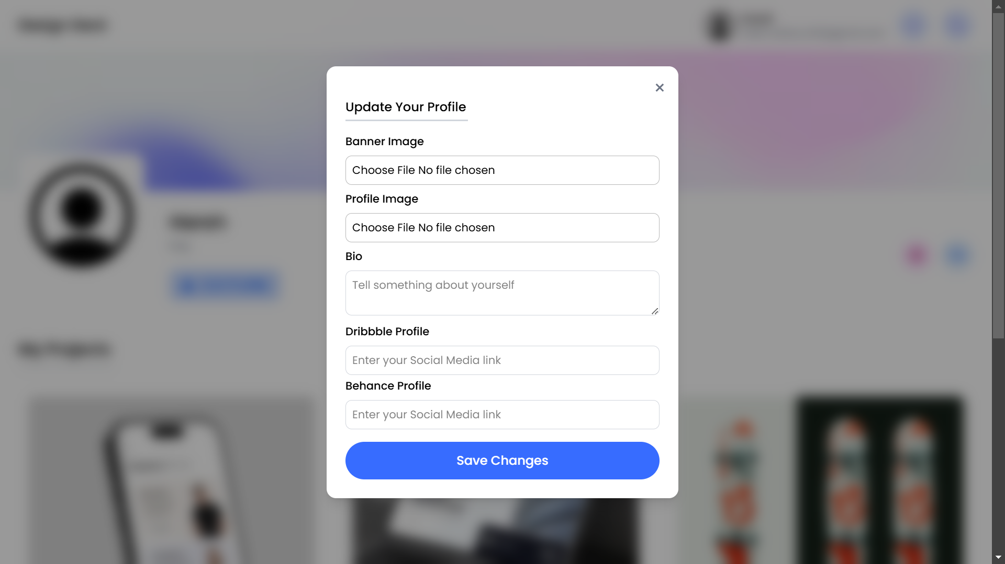
Screenshot Showcase : Frontend Development
Profile Page
Profile Page with edit popup

Slide 16
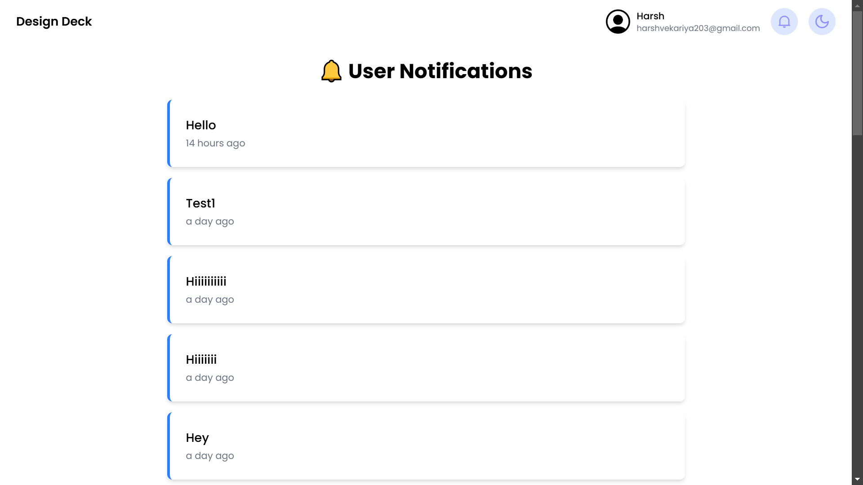
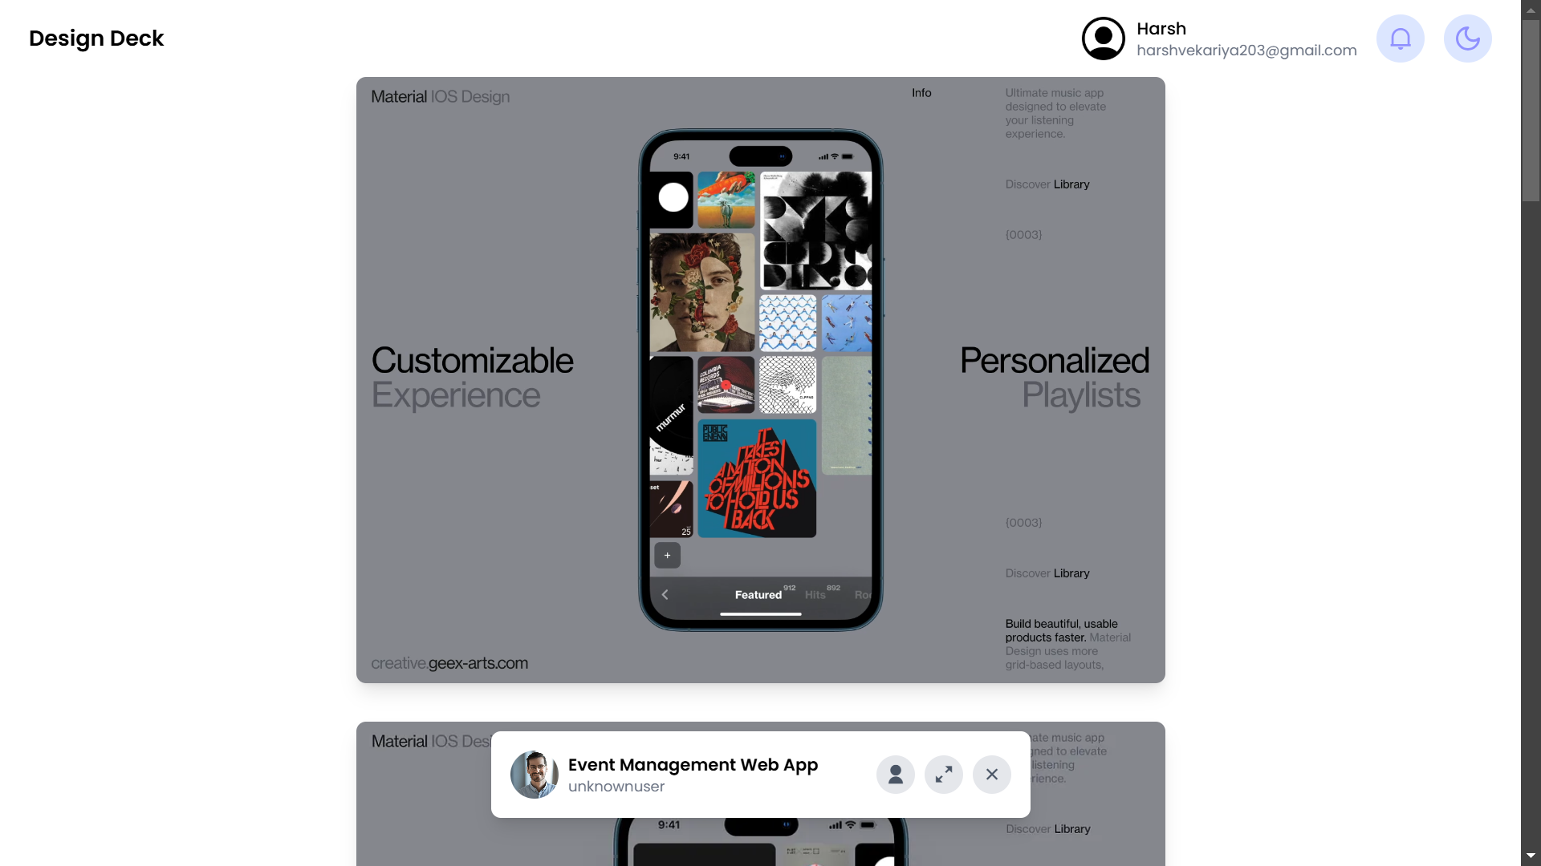
Screenshot Showcase : Frontend Development
Notification Page
Project View Page

Slide 17
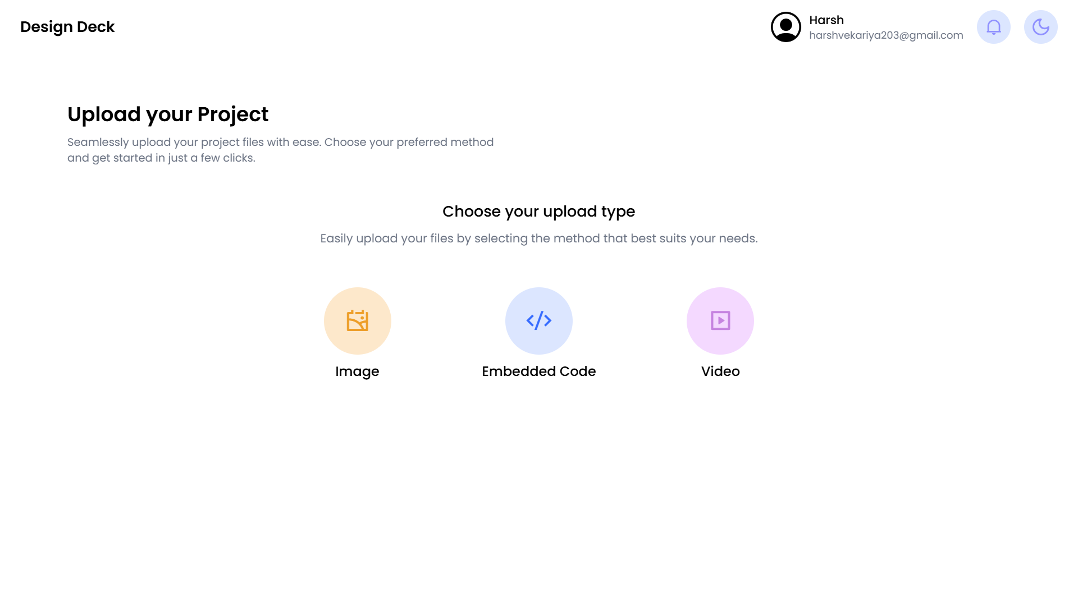
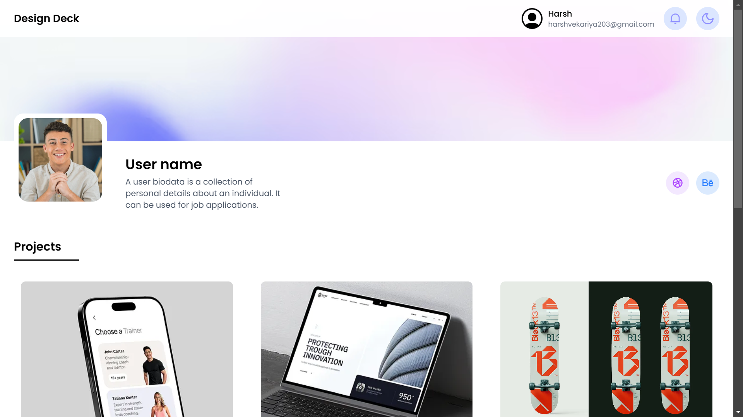
Screenshot Showcase : Frontend Development
Project Upload Page
Profile Page for other users

Slide 18
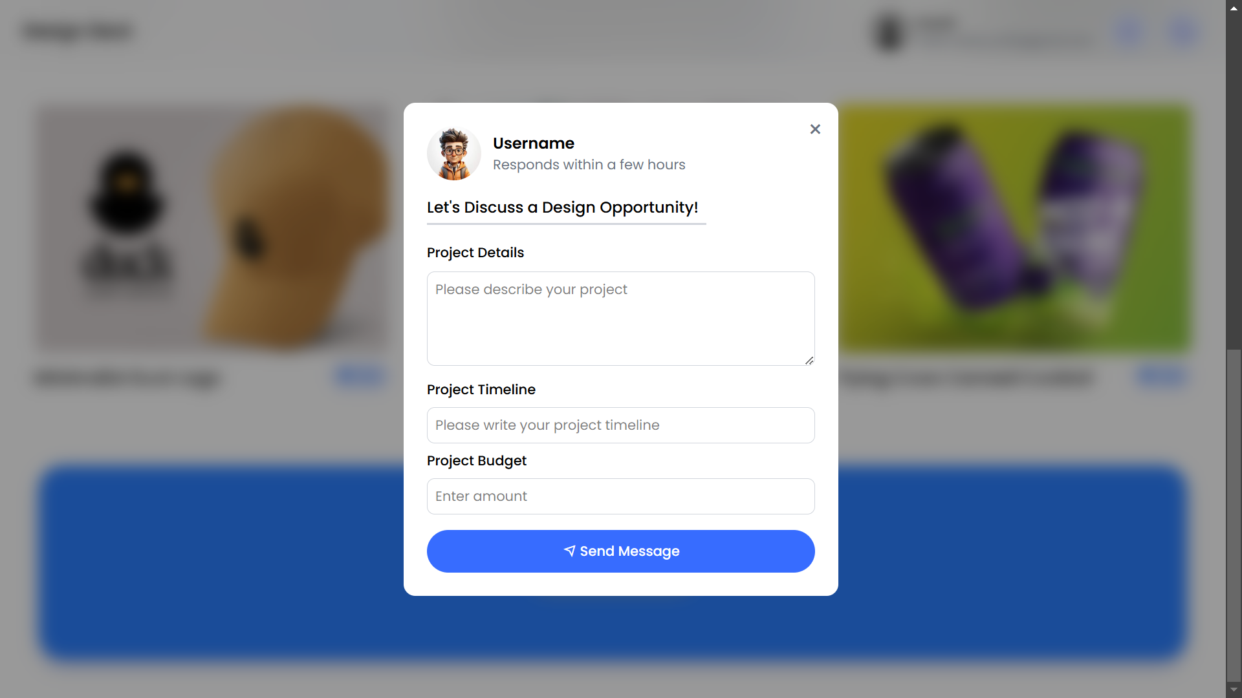
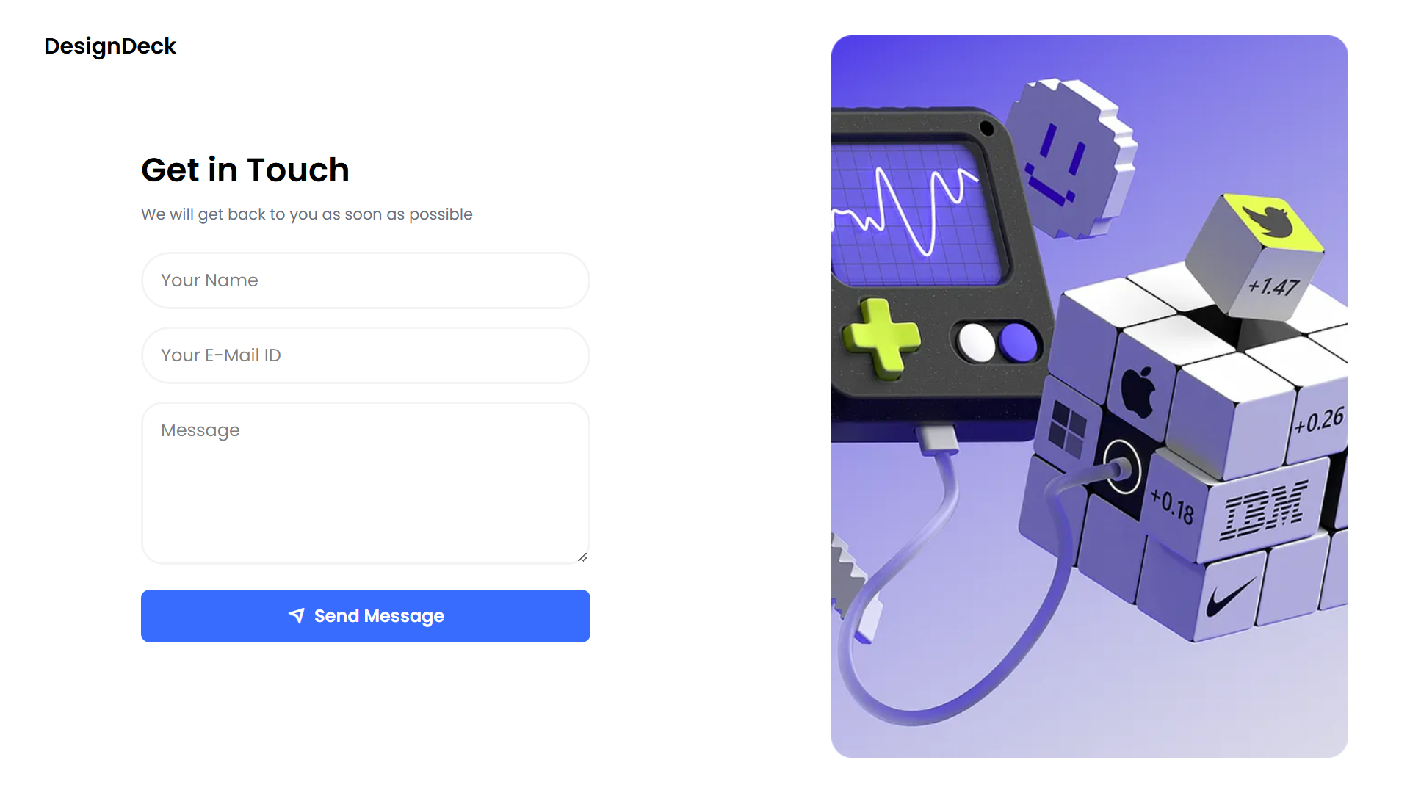
Screenshot Showcase : Frontend Development
Other users contact popup
Contact us Page

Slide 19
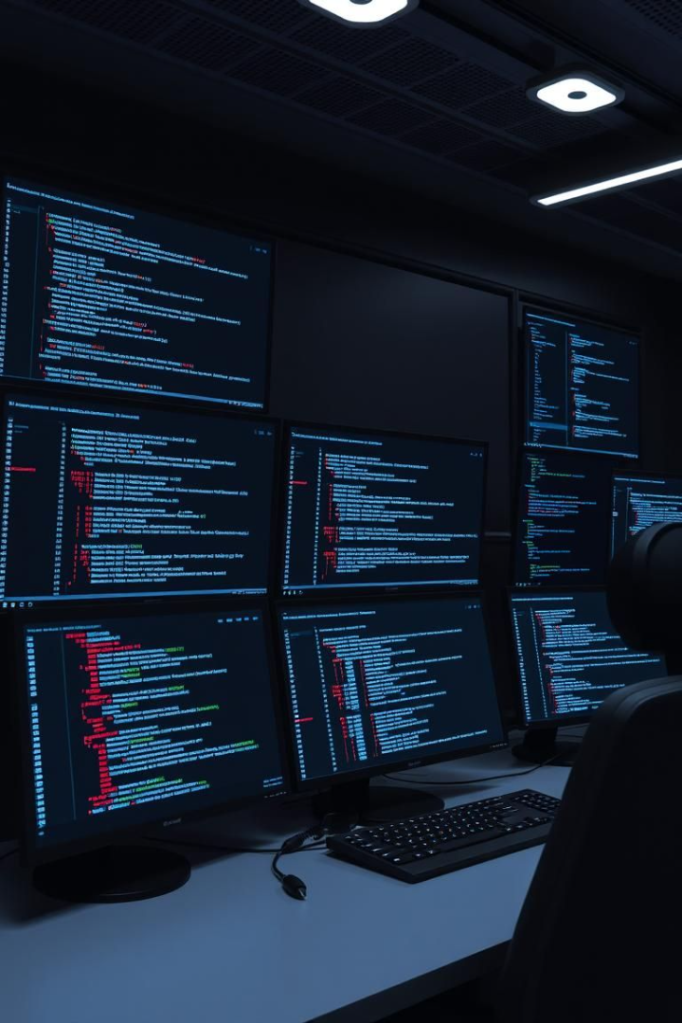
Backend Development: In Progress
1
Technologies
Node.js, Express.js, MongoDB.
2
Functionality
40% of core backend services are functional.
3
Progress
Database schema.

Slide 20




Authentication: Secure and Flexible
Normal Login
Google OAuth
Password Reset
Username/password authentication.
Simplified signup/login.
Secure account recovery.

Slide 21

Admin Panel: Control and Management
User Management
Notifications
Login Status
Manage user accounts and permissions with ease.
Stay informed with real-time updates and alerts.
Monitor user activity and ensure system security.

Slide 22


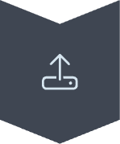

Upcoming Features: Backend Roadmap
Profile Editing
User information and preferences.
Project Uploads
File management and version control.
Mail System
We can email to all users directly to inform about
New updates or features.

Slide 23




Next Steps and Call to Action
Here's what's next for DesignDeck:
Complete Backend Development
Backend fully implemented with all features
User Testing
Evaluating user experience and functionality
Public Live
Project deployed and accessible to users

